Slide 1
C# Type System
Vesa Vlad

Slide 2
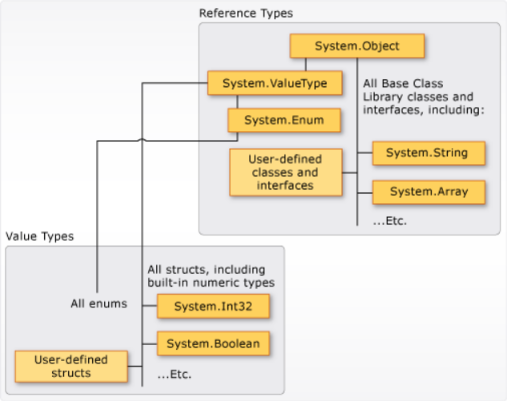
Common type system
It supports the principle of inheritance. Types can derive from other types, called base types. The derived type inherits (with some restrictions) the methods, properties, and other members of the base type.
Each type is defined as either a value type or a reference type.

Slide 3
Value type
Value type variables directly contain their values
Value types are sealed. You can't derive a type from any value type
There are two categories of value types: struct and enum
A struct is used as a container for a small set of related variables
An enum defines a set of named integral constants

Slide 4
Reference type
A type that is defined as a class, record, delegate, array or interface
Two variables can reference the same object; therefore, operations on one variable can affect the object referenced by the other variable
Reference types fully support inheritance.

Slide 5
Other types
Literal values:
Literal values receive a type from the compiler
Generic types:
A type can be declared with one or more type parameters that serve as a placeholder for the actual type
Implicit, anonymous and nullable value types:
You can implicitly type a local variable by using the var keyword
The variable still receives a type at compile time, but the type is provided by the compiler

Slide 6
Classes and records
A record is a class or struct that provides special syntax and behavior for working with data models
Records differ by:
Use of positional parameters to create and instantiate a type with immutable properties
The same methods and operators that indicate reference equality or inequality in classes indicate value equality or inequality in records
Use of a with expression to create a copy of an immutable object with new values in selected properties
ToString method creates a formatted string that shows an object's type name and the names and values of all its public properties
A record can inherit from another record but can’t inherit from a class or a class from a record

Slide 7
Interfaces and generics
Interfaces:
An interface is like an abstract base class with only abstract members
An interface can't be instantiated directly
Generics:
Generics offer the possibility to design classes and methods that defer the specification of one or more types until the class or method is declared and instantiated
The most common use of generics is to create collection classes.
Custom generic interfaces, classes, methods, events, and delegates can be created

